Slide 1
Modified Cosmology Models from Thermodynamical Approach
Jhih-Rong Lu (NTHU)
Collaborators: C. Q. Geng, Y. T. Hsu, L. Yin
Reference: arXiv: 1911.06046 [gr-qc]
NCTS Dark Physics Workshop
January 09-11, 2020 - NCTS, 3rd General Building, NTHU, Hsinchu, Taiwan

Slide 2
Outline
Introduction
The Models
Power Law Corrected Entropy Model (PLCE)
Tsallis Entropy Cosmological Evolution Model (TECE)
Numerical Results
Summary

Slide 3
Introduction
The Models
Power Law Corrected Entropy Model (PLCE)
Tsallis Entropy Cosmological Evolution Model (TECE)
Numerical Results
Summary

Slide 4
Thermodynamics and Gravity
In 1972, J. Bekenstein suggested that black hole entropy should be proportional to its horizon area, i.e., $S∝A.$ [J. D. Bekenstein, Lett. Nuovo Cimento 4, 737 (1972)]
In 1973, Bardeen, Carter, and Hawking showed that black holes obey certain laws which bear a remarkable mathematical resemblance to laws of thermodynamics, e.g., $δM=\frac{κ}{8πG}δA+Ω_{H}δJ_{H}+…$ [Commun. math. Phys. 31, 161-170 (1973)]
In 1975, Hawking further demonstrated that, in quantum theory, black holes emit Hawking radiation with a perfect thermal spectrum, i.e, $T=κ/2π$. [Commun. Math. Phys. 43, 199 (1975)]
Thus, we are able to identify entropy with horizon area, and determine the proportionality constant to be 1/4G, i.e., $S=\frac{A}{4G}.$
Note: We use units of $c=ℏ=k_{B}=1$.

Slide 5
Thermodynamics and Gravity
In BH physics, the temperature and entropy are associated with the surface gravity and area of the horizon. [J. D. Bekenstein, Lett. Nuovo Cimento 4, 737 (1972) ; Comm. Math. Phys., Volume 31, Number 2 (1973), 161-170; Phys. Rev. D. 7.2333(1973); Comm. Math. Phys. 43, 199 (1975)]
In 1995, T. Jacobson further showed that Einstein equation can be derived from the thermodynamic behavior of spacetime.[arXiv: gr-qc/9504004v2]
In 2005, R. G. Cai and S. P. Kim demonstrated that the Friedmann equations can be derived from the first law of thermodynamics on the apparent horizon of the universe.[arXiv:gr-qc/0611071v2]
Connection between thermodynamics and modified gravity theories (such as f(R) gravity, scalar-tensor theories, Gauss-Bonnet gravity…) has been widely investigated. [Ge, Phys. Lett. B 651, 49 (2007); Cai, Cao, Hu and Kim, Phys. Rev. D 78, 124012 (2008)]; Cai and Cao, Phys. Rev. D 75, 064008 (2007); Akbar and Cai, Phys. Lett. B 635, 7 (2006)…]

Slide 6
From First Law to Friedmann Equations
R.-G. Cai and L.-M. Cao, Phys. Rev. D 75, 064008 (2007)
$S=\frac{A}{4G}$
$δQ=−dE=A\left(ρ_{m}+P_{m}\right)H r_{A}dt$& $δQ=TdS$
together with the continuity equation:
$${\dot{ρ}}_{m}+3H\left(ρ_{m}+P_{m}\right)=0$$
where $r_{A}=\frac{1}{\sqrt{H^{2}+k/a^{2}}}, T=\frac{1}{2πr_{A} }, A=4πr_{A}^{2}.$
$$⇒\left\{\begin{aligned}H^{2}+\frac{k}{a^{2}}=\frac{8πG}{3}ρ_{m} \\ \dot{H}−\frac{k}{a^{2}}=−4πG(ρ_{m}+P_{m})\end{aligned}\right.$$

Slide 7
Introduction
The Models
Power Law Corrected Entropy Model (PLCE)
Tsallis Entropy Cosmological Evolution Model (TECE)
Numerical Results
Summary

Slide 8
Power Law Correction Entropy (PLCE) Model
$S_{pl}=\frac{A}{4 L_{P}^{2}}(1−K_{ν}A^{1−\frac{ν}{2}})$, $K_{ν}=\frac{ν{\left(4π\right)}^{(ν−2)/2}}{(4−ν)r_{c}^{2−ν}}, r_{c}=H_{0}^{−1}.$
$$\left\{\begin{aligned}H^{2}=\frac{8πG}{3}\left(ρ_{m}+ρ_{r}+ρ_{DE}\right), \\ \dot{H}=−4πG\left(ρ_{m}+ρ_{r}+ρ_{DE}+P_{m}+P_{r}+P_{DE}\right), \end{aligned}\right.$$
where
$ρ_{DE}=\frac{3}{8πG} \frac{1}{r_{c}^{2−ν}}\left(H^{ν}−1\right)+\frac{Λ}{8πG}$,
$P_{DE}=\frac{−1}{8πG}\left[\frac{ν\dot{H}}{r_{c}^{2−ν}}\left(H^{ν}−1\right)+\frac{3}{r_{c}^{2−ν}}\left(H^{ν}−1\right)+Λ\right]$.

Slide 9
Tsallis Entropy Cosmological Evolution (TECE) Model
$S_{T}=\frac{\tilde{α}}{4 G}A^{δ}$
$$\left\{\begin{aligned}H^{2}=\frac{8πG}{3}\left(ρ_{m}+ρ_{r}+ρ_{DE}\right), \\ \dot{H}=−4πG\left(ρ_{m}+ρ_{r}+ρ_{DE}+P_{m}+P_{r}+P_{DE}\right), \end{aligned}\right.$$
where
$ρ_{DE}=\frac{3}{8πG} \left[H^{2}\left(1−\frac{αδ}{2−δ}H^{2(1−δ)}\right)+\frac{Λ}{3}\right]$,
$P_{DE}=\frac{−1}{8πG}\left[\frac{ν\dot{H}}{r_{c}^{2−ν}}\left(H^{ν}−1\right)+\frac{3}{r_{c}^{2−ν}}\left(H^{ν}−1\right)+Λ\right],$
$$\left(α≡{\left(4π\right)}^{δ−1}\tilde{α}\right).$$

Slide 10
Introduction
The Models
Power Law Corrected Entropy Model (PLCE)
Tsallis Entropy Cosmological Evolution Model (TECE)
Numerical Results
Summary

Slide 11
Numerical Results
We use the CosmoMC program to perform the global fitting for the PLCE and TECE model.
Dataset:
CMB : Planck 2015
(TT, TE, EE, and lensing from SMICA)
BAO : Baryon acoustic oscillation data from BOSS
Weak lensing data from CFHTLenS
H(z) data and ${fσ}_{8 }$data

Slide 12
$PLCE:S_{pl}=\frac{A}{4 L_{P}^{2}}\left(1−K_{ν}A^{1−\frac{ν}{2}}\right)$

Slide 13
$PLCE:S_{pl}=\frac{A}{4 L_{P}^{2}}\left(1−K_{ν}A^{1−\frac{ν}{2}}\right)$
$χ_{PLCE}^{2}=3017.12$;
$χ_{ΛCDM}^{2}=3018.32$

Slide 14
$TECE:S_{T}=\frac{\tilde{α}}{4 L_{P}^{2}}A^{δ},$
$$with \tilde{α}=1, δ=1+ξ$$

Slide 15
$TECE:S_{T}=\frac{\tilde{α}}{4 L_{P}^{2}}A^{δ}$
$\tilde{α}=1, δ=1+ξ$
$χ_{TECE}^{2}=3018.96$;
$χ_{ΛCDM}^{2}=3019.28$

Slide 16
Summary
We compare the cosmological result of the two models with those of $ΛCDM$.
For PLCE model, we have obtained that $χ_{PLCE}^{2}<χ_{ΛCDM}^{2}$.
For TECE model, we have a non-zero central value with a relaxed upper bound for total neutrino mass. Also, we have $χ_{TECE}^{2}<χ_{ΛCDM}^{2}$.
Thanks For Your Attention!

Slide 17
Back-up slides

Slide 18
Power Law Corrected Entropy [Phys. Rev. Lett. 71 (1993) 666-669, Phys. Rev. D 77, 064013 (2008)]
Black hole entropy, $S_{BH}=A/4G$, can be associated with entanglement entropy.
Consider a massless scalar field inside a spherical surface of radius $R.$ It can be shown that if the scalar field is in ground state, then the entanglement entropy will be $S\sim A_{sphere}/l^{2}$ where $A_{sphere}=4πR^{2}$ is the area of the sphere, and $l$ is the cutoff at the surface. [Phys. Rev. Lett. 71 (1993) 666-669]
Thus, the black hole entropy can be regarded as a consequence of the entanglement of quantum fields across the horizon.
If further consider the excited states together with the ground states, the entropy will be power-law corrected, i.e.,
$S\sim \frac{A_{sphere}}{l^{2}}\left(1+c{\left(\frac{A_{sphere}}{l^{2}}\right)}^{−ν}\right), c is constant.$ [Phys. Rev. D 77, 064013 (2008)]

Slide 19
Tsallis Entropy[C. Tsallis, J. Statist. Phys. 52, 479 (1988), C. Tsallis and L. J. L. Cirto, Eur. Phys. J. C 73, 2487 (2013)]
In information theory, there are various ways to define entropy. More generalized version of entropy is, for example, Tsallis and Renyi. And of course, you can transform these types of entropy back to the Boltzman version.
And the non-extensive property of Tsallis or Renyi seem to resemble with the area law of BH.
So someone starts to investigate BH thermodynamics based on those types of entropy. And it was found that thermodynamic stability of BH differ from those of Boltzman entropy version.

Slide 21
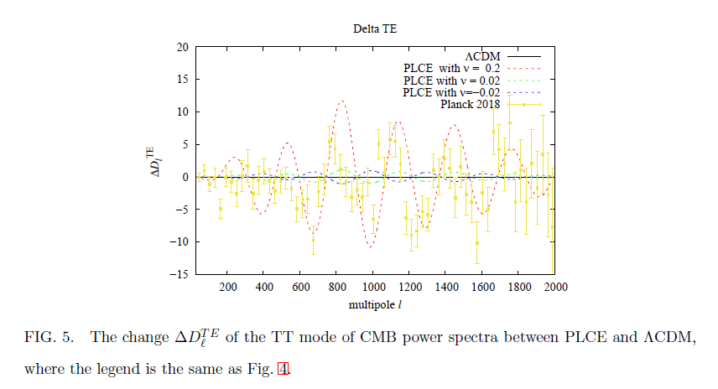

Slide 24
PLCE: EoS

